Slide 1
Notes:
SAWS PE

Slide 2
Meeting Agenda
Oral Statements
Project Overview
Pre-Bid Meeting
Contract Requirements
Required Experience
SMWB
Change Request
Bid Packet Preparation
Additional Reminders
Communication
Key Dates
Contract Reminders
Project Overview
Coordination
Contract Requirements
Special Provisions
Special Specifications
Supplemental Conditions
Special Conditions
Notes:
SAWS PE

Slide 3
Oral Statements
Oral statements or discussion during the pre-bid meeting will not be binding, nor will it change or affect the terms or conditions within the Plans and Specifications for this Project. Changes, if any, will be addressed only via an Addendum.
Notes:
SAWS PE

Slide 4
Project Overview
Purpose of the project is to construct a pipeline to connect new well sites to an existing pipeline
Approximately 19,500 LF of 12-inch and 18-inch DR 11 HDPE pipe
Average depth of cover is approximately 7 ft
Tie-in to exiting 24-inch HDPE pipeline
Notes:
SAWS PE

Slide 5
Pre-Bid Meeting
Non-mandatory pre-bid meeting
Attendees should sign-in and sign-in sheet will be posted on SAWS website
Key project information:
Construction duration is 180 calendar days
Construction estimate is $2,560,000.00
Construction services being procured through IFB
Notes:
Contracting

Slide 6
Contract Requirements
Prevailing Wage Rate and Labor Standards – Section 2.10 of the General Conditions
Certified payroll to be submitted on weekly basis
Wage decisions are included within the specifications
Contractors to utilize LCP Tracker
Site visits are random and unannounced
Interviews will be conducted and will be private & confidential
Payroll records are subject to review
All apprenticeship programs will need to be approved by Department of Labor prior to starting
Contractors are responsible for sub-contractor payroll
Late payrolls delay contractor payments from SAWS
Notes:
Contracting

Slide 7
Contract Requirements (Continued)
Insurance requirements are found in Section 5.7 of the GCs
Construction w/ Pollution, Installation Floater & XS 2 Million
Maintain insurance coverage during the construction of this Project
Submittals and invoicing will be handled through CPMS
Notes:
Contracting

Slide 8
Required Experience
Contractor shall have experience constructing 12 to 24-inch HDPE pipelines.
Detailed requirements are included in the Statement of Bidder’s Experience, which must be completed by the contractor.
Notes:
Contracting

Slide 9
Aspirational SMWB Goal
Industry | SMWB Goal
Construction | 20%
Notes:
Contracting

Slide 10
Accepted SMWVB Certification Agency
South Central Texas Regional Certification Agency
(Includes the Texas Historically Underutilized Business “HUB” Program)
Minimum Qualifications for SMWVB recognition:
SBE-Certified (even MBEs and WBEs)
Local office or local equipment yard
Notes:
SMWB

Slide 11
Accepted SMWVB Certifications
Minority Business Enterprise (MBE) (Includes AABE, ABE, HABE, and NABE)
Small Business Enterprise (SBE)
Woman-owned Business Enterprise (WBE)
Veteran-owned Business Enterprise (Tracked, but not eligible for points)
Notes:
SMWB

Slide 12
Good Faith Effort Plan (GFEP) FAQs
Q: Is the 20% SMWB goal mandatory?
A: No, but we ask prime consultants to do their best with good faith outreach efforts. If the goal is not met, proof of outreach efforts is required with the submittal.
Q: What if I am having trouble finding SMWB subconsultants?
A: Please email the SMWVB Program Manager with the scopes of work you are seeking. You will receive lists of local SMWVB-certified firms to contact.
Q: What if my business is SMWB-certified? Do I need to find SMWB subs?
A: If your firm is SMWVB-certified, you will most likely meet the goal. However, the GFEP is a required document, and a good faith outreach effort is still necessary.
Q: What if I have questions about the GFEP?
A: Please contact the SMWVB Program Specialist at 210-233-3420, or at Marisol.Robles@saws.org. GFEP questions can be asked at any time before the submittal is due.
Notes:
SMWB

Slide 13
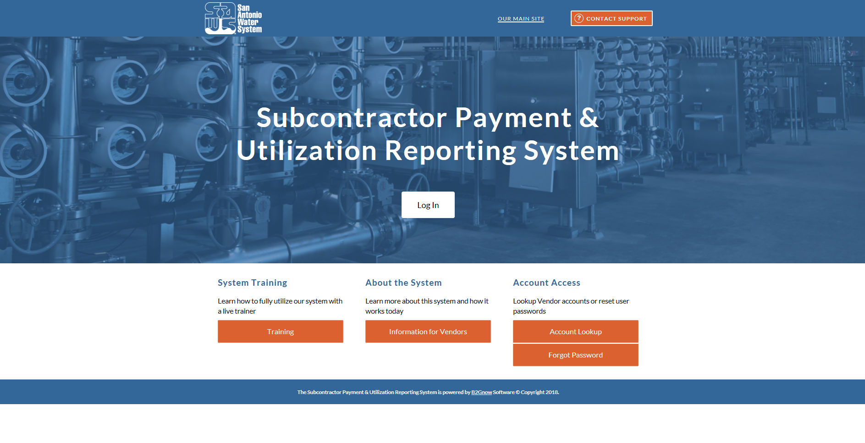
Post Award: Subcontractor Payment & Utilization Reporting (S.P.U.R.) System & Subcontractor Changes
https://saws.smwbe.com

Slide 14
Bid Packet Preparation
Utilize and submit the Bid Packet Checklist with the Bid
Statement of Bidder’s Experience be completed and included instead of list of projects
Double check all mathematical calculations and verify all extensions
Ensure Mobilization and Preparation of ROW do not exceed the allowed percentages (10% and 5%) respectively
References and contact information should be verified prior to submitting a Bid
Addendums are acknowledged on the Bid Proposals Signature Page
Bidders shall include all required items with their bid packet
Notes:
Contracting

Slide 15
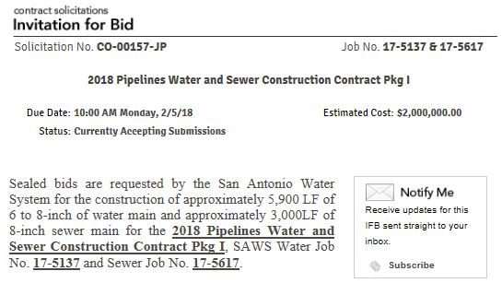
Additional Reminders
Register with Vendor Registration Program on the SAWS website at www.saws.org to ensure access to the latest information.
To receive updates on specific projects, registered vendors should subscribe to the project by selecting the project, and clicking ‘Subscribe’ under the Notify Me box.
Notes:
Contracting

Slide 16
Communication Reminders
There should not be any communication with the following:
Design Engineer (Merrick)
SAWS Project Manager or Project Engineer
Any other SAWS staff
City Council member or staff
SAWS Board of Trustees
This includes phone calls, emails, letters, or any direct or indirect discussion of the Bid.
Notes:
Contracting

Slide 17
Key Dates
April 1, 2020 by 4:00 PM Questions Due
April 6, 2020 by 4:00 PM Addendum Posted to SAWS Website
April 13, 2020 by 2:00 PM Bid Proposals Due
April 2020 Responsible Bidder Evaluation
May 2020 Selected Contractor Notified
*May 5, 2020 SAWS Board Approval and Award
Week of May 25, 2020 NTP Issued
*SAWS intends to expedite execution of this contract. Bidder will be expected to provide signed contract, performance and payment bonds and insurance within days of the bid opening.
Notes:
Contracting

Slide 18
Key Dates - Submission Due Date
Bids are due no later than 2:00 PM CT Monday, April 13, 2020
Follow specific delivery instructions:
Deliver to 2800 U.S. Highway 281 North, Customer Service Building, Counter Services
Make arrangements if mailing a bid
Late responses will not be accepted and will be returned unopened
Should the City of San Antonio extend the Stay at Home order past April 9, SAWS will make accommodations for the bid drop off
Notes:
Contracting

Slide 19
Contract Reminders
Contractors must include a “Baseline Construction Schedule” (CPM method) with the Bid Proposal and acknowledged in the Bid Packet Checklist.
Submittals can be submitted as soon as receiving notification of contract award after CPMS training (if necessary) has been completed.
Anticipated NTP week of May 25, 2020.
Notes:
Contracting

Slide 20
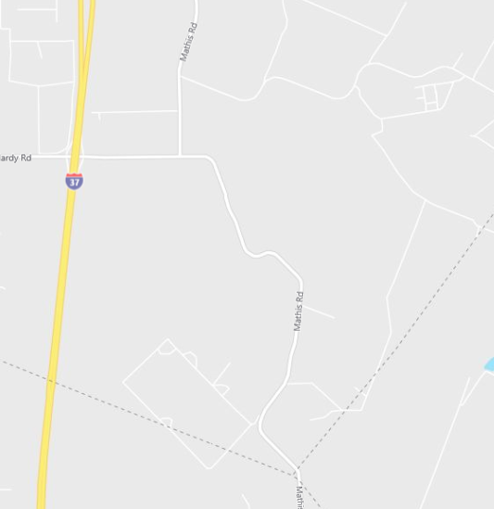
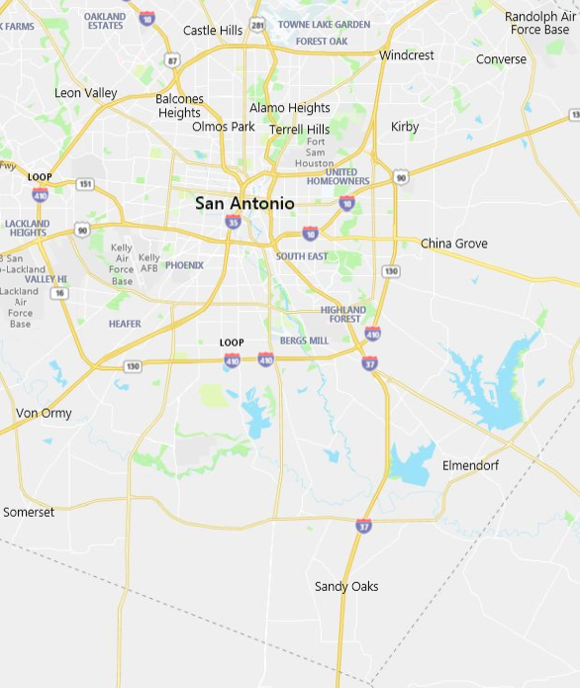
Project Overview - Map
Project Area
Project Area
Notes:
Consultant

Slide 21
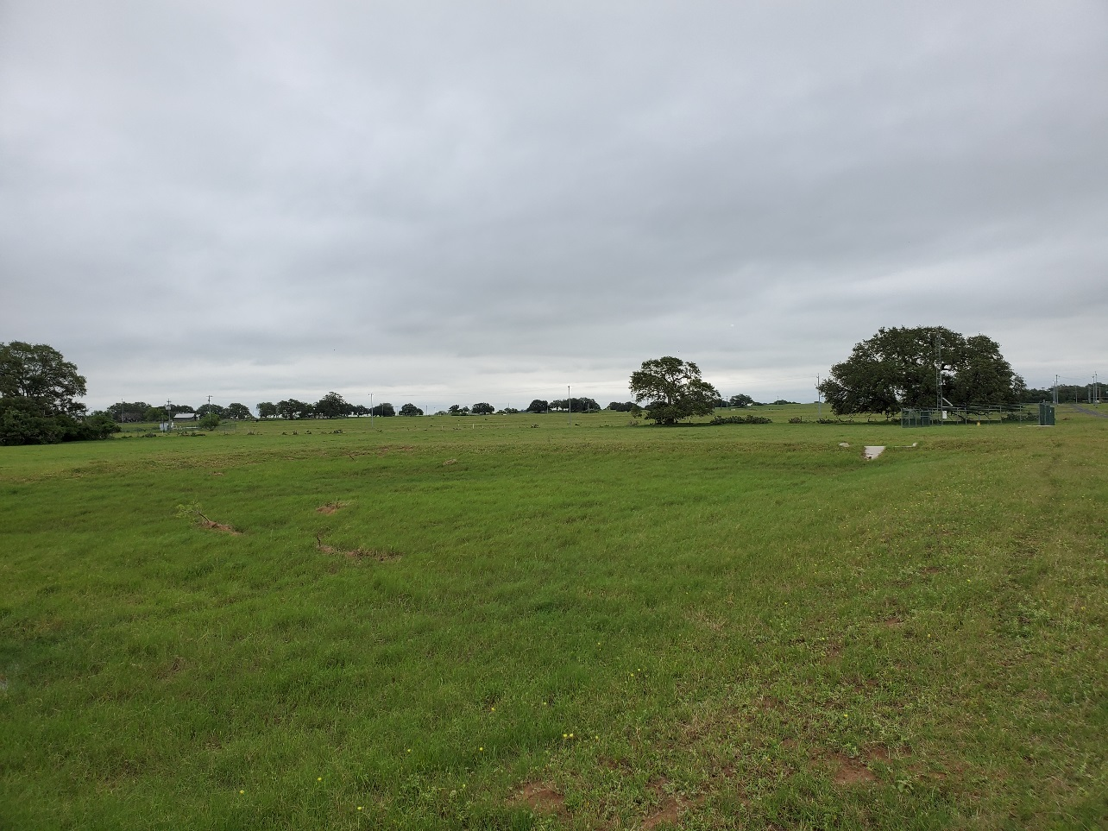
Project Overview
New 12-inch and 18-inch HDPE water pipeline
Undeveloped pasture, SAWS owned
One bore across Bexar Co. ROW
Two floodplain crossings
Various access road crossings
Existing pipe crossings
In Bexar and Wilson Counties
Connection to existing HDPE Pipeline
Tree Protection
Notes:
Consultant

Slide 22
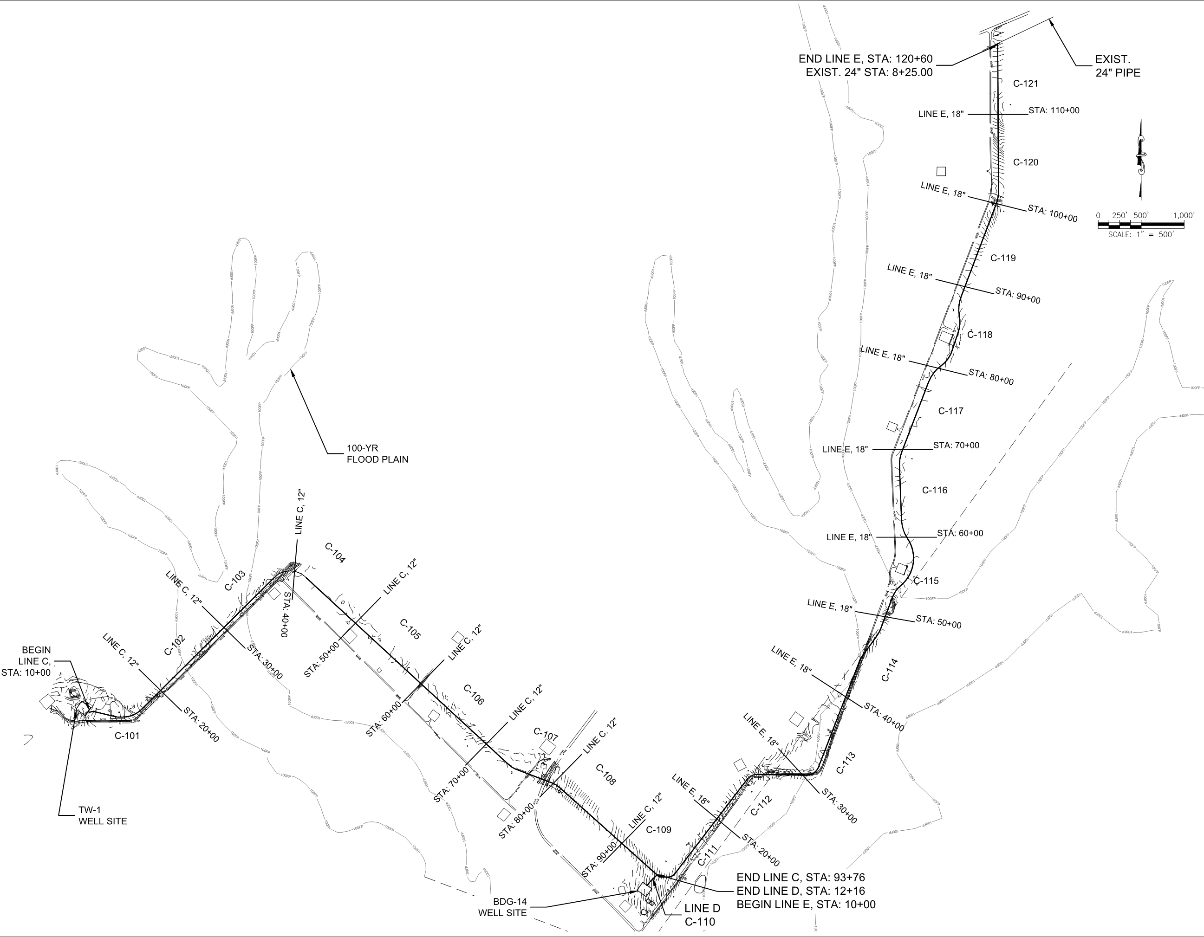
Project Overview (Continued)
Flood Plain
Exist. Tie-In
Mathis Rd Crossing
Flood Plain
Wilson Co. Section
Notes:
Consultant

Slide 23
Coordination
SAWS Operations
Site Access & Security Clearance
Existing Site Access
Existing Pipeline Tap
Wellsite Contractor (separate contract)
Bexar County
Wilson County
City of San Antonio
Notes:
Consultant

Slide 24
Contract Requirements – Supplemental Conditions
Key Supplemental Conditions
Baseline Schedule & Experience w/ Bid
Notes:
Consultant

Slide 25
Contract Requirements – Special Conditions
Key Special Conditions
Geotechnical information available for review
Coordination w/ Well Site Contractor
Existing Utilities (incl. Oil & Gas)
Notes:
Consultant

Slide 26
SMWVB Questions
Questions related to SMWVB may be directed to SAWS’ SMWVB Program Manager until bids are due. Her contact information is as follows:
Marisol V. Robles
Contract Administration Department
San Antonio Water System
Email Address: Marisol.Robles@saws.org
Telephone No.: (210) 233-3420
Notes:
Contracting

Slide 27
Questions
Should be submitted no later than April 1, 2020 at 4:00 PM CDT.
Must be submitted in writing:
Roxanne L. Lockhart
Contract Administrator
Contract Administration Department
San Antonio Water System
Roxanne.Lockhart@saws.org
Fax: (210) 233-3095
Notes:
Contracting

Slide 28
Notes:
Contracting

